Slide 1
Ranking Matters!!!
fujiayuan0418@gmail.com
Shampa Shahriyar (shampa077@gmail.com)

Slide 2
Dataset Analysis and Visualization
Target :
Effectiveness of product Ranking System
Key differences between the online and call-center channels
Prediction on sale
Anomalies in Data:
This data set doesn’t include all the parameter used for ranking system, specially customer details or their requirement
For some products “dummy_quote_values” are missing
Its really not clear how “dummy_quote_values” are calculated as in different search product with same provider and same ranking are having different quote values.

Slide 3
Dataset Analysis and Visualization
General Information :
Total 16 products are listed from 2 providers
Total 628 search histories are recorded
234 products were sold (54 from Provider B and 180 from Provider A)
Each search can have maximum 12 product suggestion and they are ranked from 1(high) to 12(low).

Slide 4
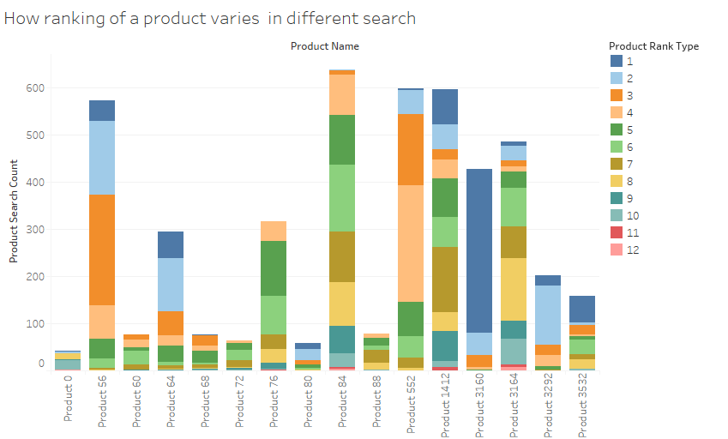



Consistency of Ranking System
Product search count represents how many times that product was listed in the search result
This product is constantly ranked 2nd or 3rd
This product is constantly ranked higher
This product’s ranking for different search is not consistent

Slide 5
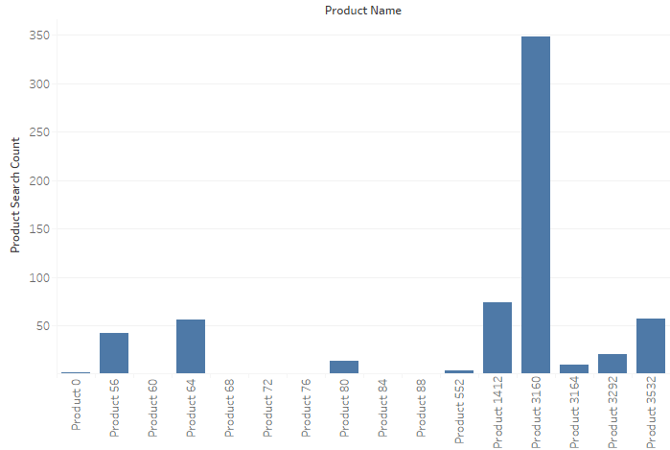
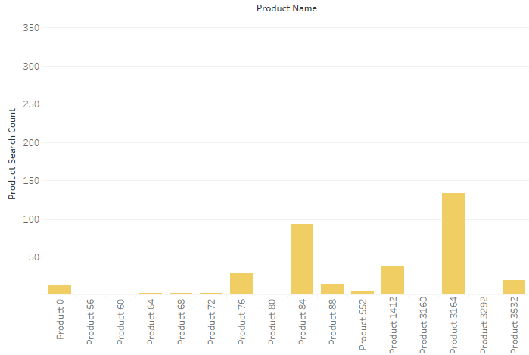
Consistency of Ranking System
Rank 1
Rank 8
Product 3160 is most popular by rank
Product 3164 is less popular by rank

Slide 6
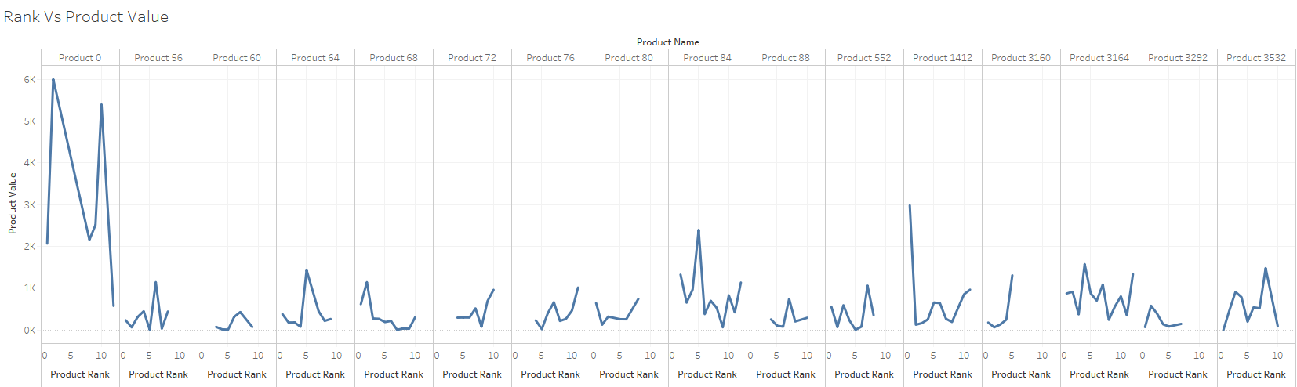
If Ranking is Affected by Product Price??
Its really hard to tell from this data the relationship of product price and ranking

Slide 7
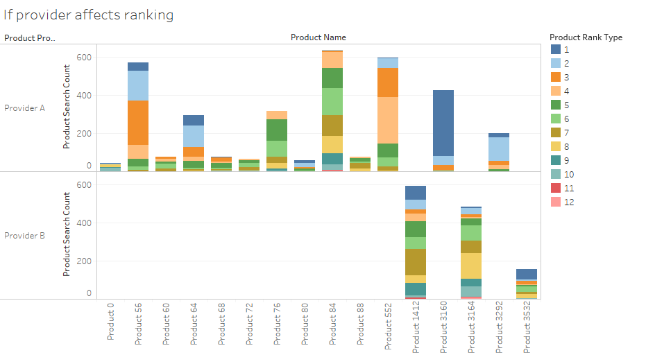
If Ranking System is Preferring Certain Provider??
Possible Cases:
1) provider B offers less variety of products
2) not sufficient data in this dataset for Provider B
Most of the products are from Provider A
Product 1412 is the popular product from Provider B

Slide 8
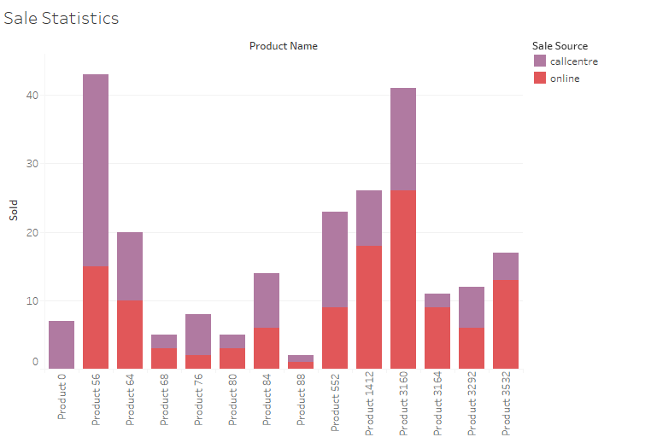
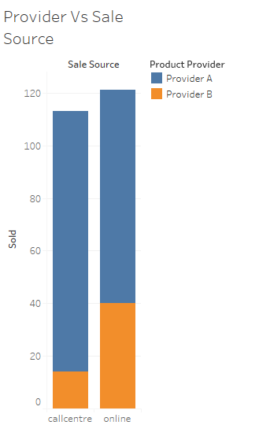
Sale Statistics
Product 56 and 3160 are popular items for sale
No significant difference in sale percentage due to sale source
Provider A is offering more product variety, therefore their sale %is higher

Slide 9
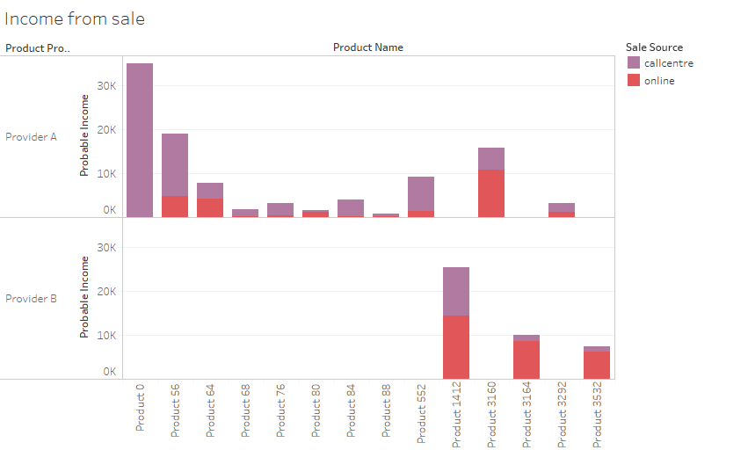
Income
Although Product 0 is not popular item for sale , however it’s income is higher due to high product value.

Slide 10
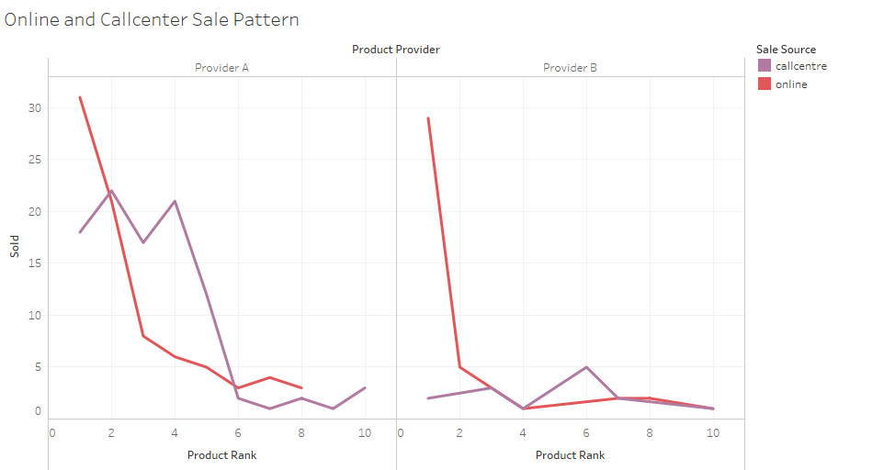
Key Differences Between the Online and Call-Centre Channels
People usually trust high ranked product when they buy online, which is not always true for call center. When people buy something via call center they rely more on people’s (sale representative’s) recommendation rather than ranking of products

Slide 11
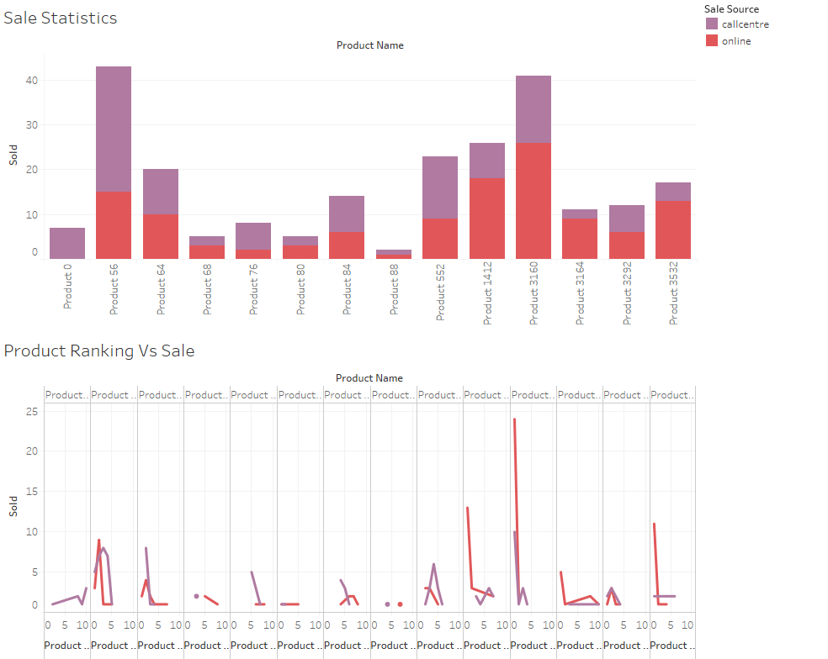
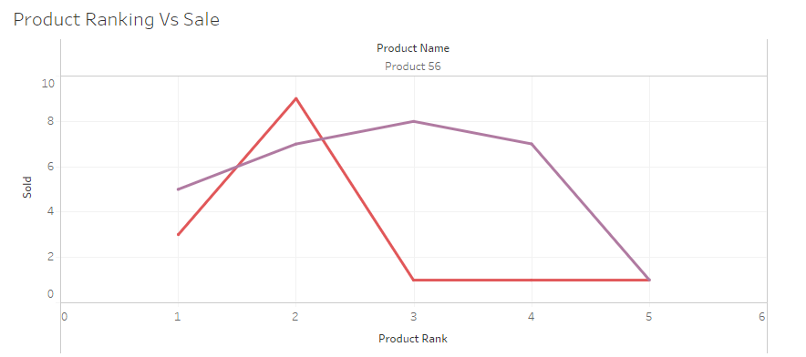
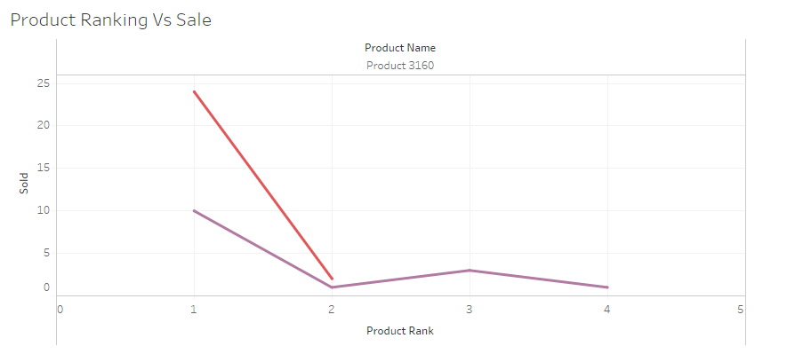
How Ranking is Affecting Product Sale
Lower rank does not affect call center sale for Product 56, however it affects online sale
Product 0 is not so popular in online sale due to high price
Product 3160 is popular in online sale for higher rank

Slide 12
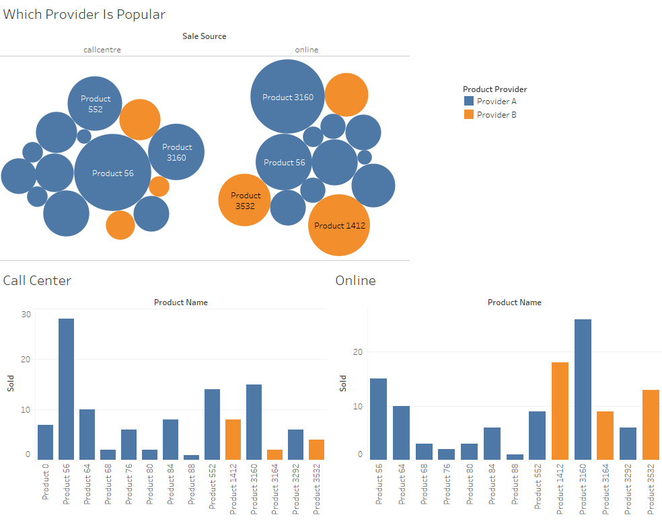
Provider and Product
Sale | A | B
234 | 180 | 54
Sale | Online | Call
A | 81 | 99
B | 40 | 14
No of products | A | B
16 | 13 | 3
Sale/ No of products | A | B
14.625 | 13.84 | 18
 | A | B
Online | 45% | 70%
Call | 55% | 30%

Slide 13
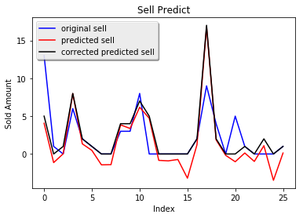
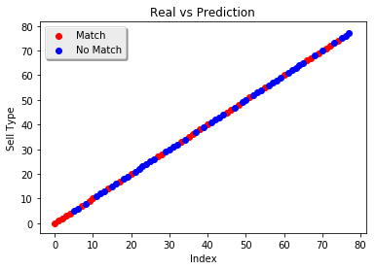
Prediction
Prediction of sales amount for product with different provider and rank
Prediction on Sale Mode Type

Slide 14
Thank you

